Slide 1

Search Engine
ABHIJEET SENAPATI (RA1811030010064)
AKSHAT GOEL (RA1811030010069)

Slide 2

What is a search engine?
Search engines is a web based application or a software which allow users to search the internet for content using keywords. Although the market is dominated by a few, there are many search engines that people can use.
When a user enters a query into a search engine, a search engine results page (SERP) is returned, ranking the found pages in order of their relevance.

Slide 3
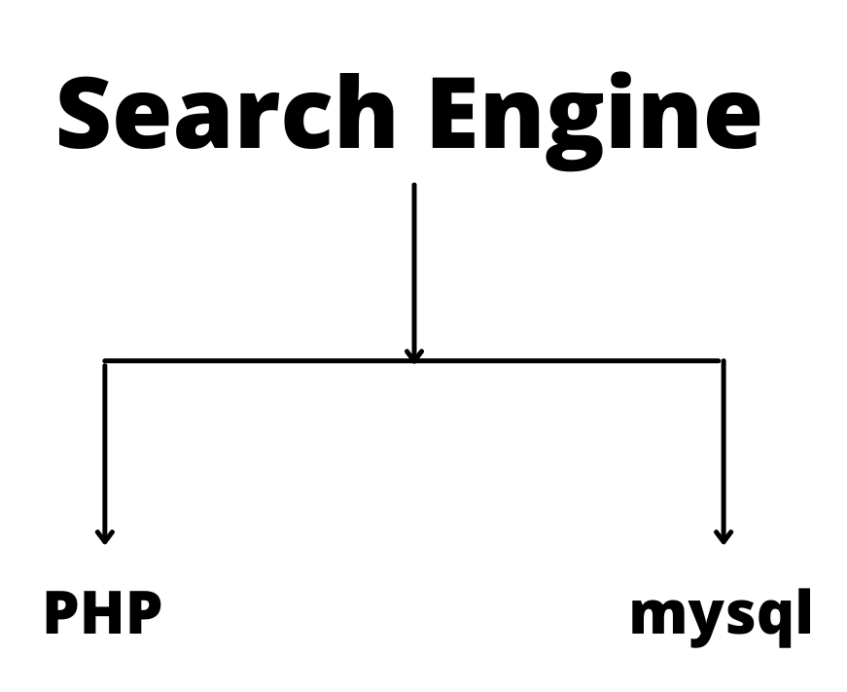

Slide 4
What is PHP ?
PHP (Hypertext Pre-Processor) is a server-side web programming language that is widely used for web development.
PHP files can contain text, HTML, CSS, JavaScript, and PHP code
PHP code is executed on the server, and the result is returned to the browser as plain HTML
PHP language has it’s roots in C and C++. PHP syntax is mostly similar to C and C++ language syntax So programmers find it easy to learn and manipulate.

Slide 5
What is MySQL?
MySQL is currently the most popular open source database server in existence.
On top of that, it is very commonly used in conjunction with PHP scripts to create powerful and dynamic server-side applications.
MySQL has stand-alone clients that allow users to interact directly with a MySQL database using SQL, but more often it is used with other programs to implement applications that need relational database capability.
MySQL is a component of the LAMP web application software stack (and others), which is an acronym for Linux, Apache, MySQL, Perl/ PHP/ Python.

Slide 6
How Search Engine Works?
The main two functions of a search engine are:-
Web page submission (e.g - Google search console)
Searcher (e.g - Google search engine)

Slide 7
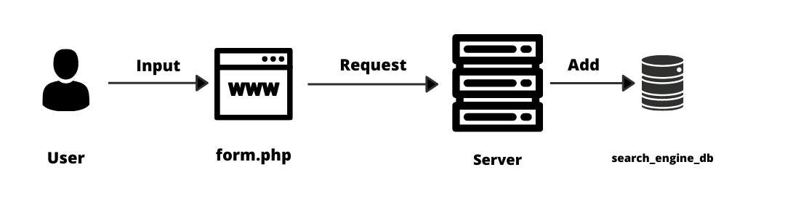
Web Page Submission

Slide 8
Web Page Submission is a service in which a user can submit his web pages to the searcher.
These web pages are stored in the database of the search engine.
According to the diagram in the previous slide, we see that the input data is taken from USER through a PHP web page and then the input data will get stored in a database through the request made by PHP web page.
form.php will be used to input data from the user and then it generates POST requests to add data to the database.
search_engine_db will be used to store input data.

Slide 9
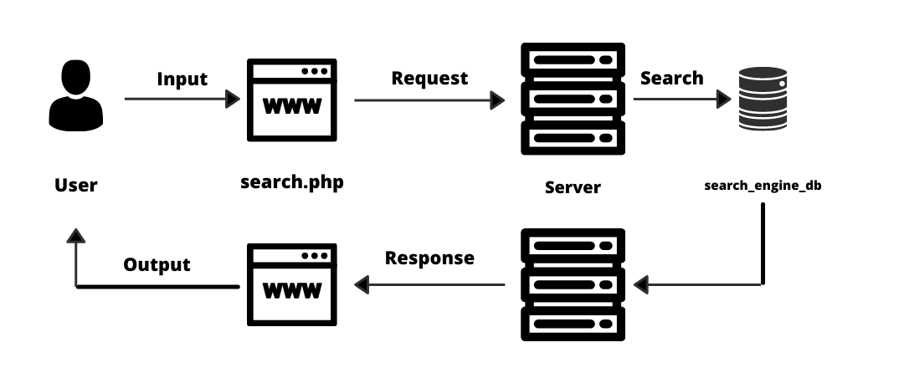
Web Searcher

Slide 10
A searcher is used to search whether the input keyword/ query is available in the database.
If the input query is available in the database it will display the results in the form of Search Engine Results Page (SERP).
search.php is used to input query from the user and then it generates GET request to search query in the database.
Then, the server will send the response according to the GET request.
The response data will be displayed as Search Engine Results Page

